Slide 1


INTEGUMENTARY
SYSTEM
lucy vermeulen, 2013, 2015

Slide 2
NENA Core Competencies: Skin
Performing wound care of the acute and chronic wound
Assisting with wound closure (e.g. suturing, staples, skin glue)
Apply topical anesthetic
Assist with local anesthetic
Ring removal
National Emergency Nurses Association, 2014
Citywide ED Orientation - May 2015

Slide 3
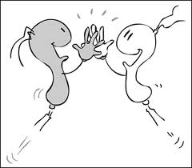
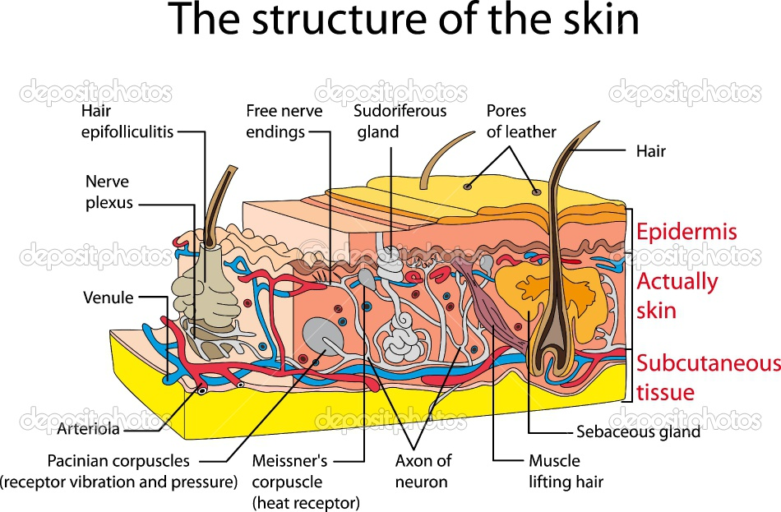
Skin is the largest organ in the human body
Significant defense system against infection
Helps prevent fluid loss
Thermo regulation
Sensory function
Citywide ED Orientation - May 2015

Slide 4
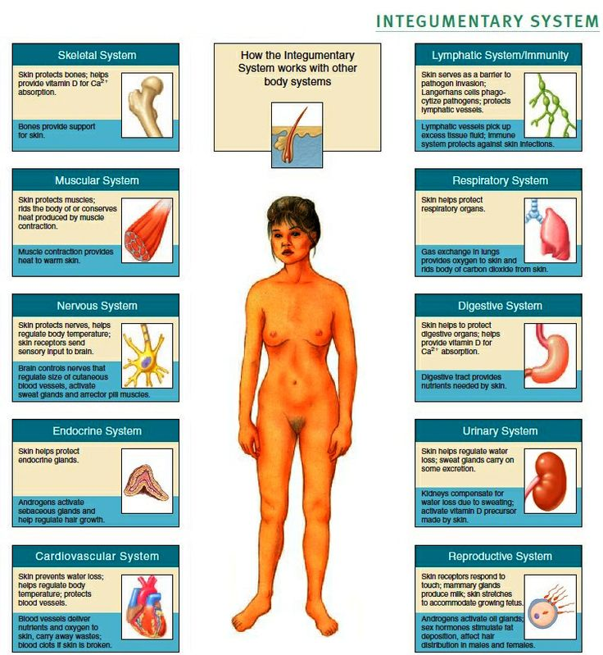
Citywide ED Orientation - May 2015

Slide 5
What is normal?
Normal
Abnormal
Warm
Pink
Dry
Moist mucous membranes
Intact
Cold
Pale/cyanotic
Diaphoretic/clammy
Dry mucous membranes
Skin broken down
Citywide ED Orientation - May 2015

Slide 6
Lacerations
Disruption of skin (and possibly underlying tissues) from a sharp object. (Any shape such as “J” “U”; edges can meet well (approximation) or
wound can be ‘gaping.’
Don’t confuse laceration with incision.
Citywide ED Orientation - May 2015

Slide 7
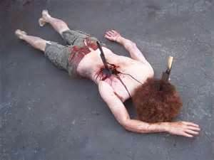
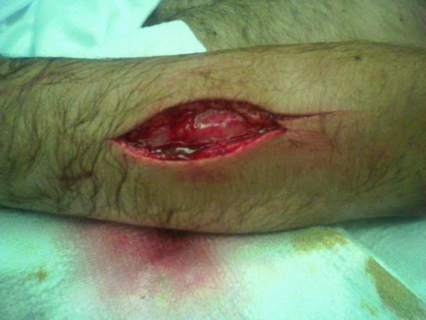
Lacerations
Varies in depth
Can penetrate underlying tissues
Can have foreign body
Can have underlying tissues protruding
With skin breakdown, risk for infection grows
Citywide ED Orientation - May 2015

Slide 8
Always check for possible bony deformities associated with lacerations
(open fractures)
Always check neurovascular status: sensation, mobility, circulation (incl.
bleeding)
This helps determine acuity & urgency
Citywide ED Orientation - May 2015

Slide 9
Sutures
Length of time they typically stay in:
Face: 3-5 days
Scalp: 7-10 days
Arms: 7-10 days
Trunk: 10-14 days
Legs: 10-14 days
Hands & Feet: 10-14 days
Medscape Education, 2008
Citywide ED Orientation - May 2015
Notes:
Medscape Education, (2008), Skin Laceration Repair Reviewed. Retrieved Dec. 31, 2012 from http://www.medscape.org/viewarticle/582653

Slide 10
Occasionally, instead of sutures, staples are used
to close lacerations.
An ER nurse might also see them in post-op patients presenting to the department.
Citywide ED Orientation - May 2015

Slide 11
Health Teaching Re: Sutures
Keep clean & dry
Do not soak in water
Watch for redness, swelling, increased pain or
discharge.
Inform patient when sutures are to be removed
Discontinue sutures with GP or Walk-in Clinic
Citywide ED Orientation - May 2015

Slide 12
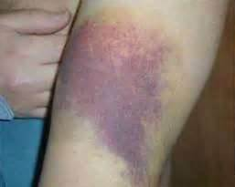
Hematomas
A collection of blood outside vessels, usually caused by trauma. It occurs because a blood vessel
has been
damaged.
MedicineNet.com, 2012
Citywide ED Orientation - May 2015
Notes:
MedicineNet.com, 2012, Hematomas. Retrieved from http://www.medicinenet.com/hematoma/article.html

Slide 13
Can occur anywhere
Can vary in depth, width and significance
Can be tender to touch
Depending on extent of blood collection & location, can cause pressure leading to oxygen depletion and cell death (e.g. epidural, intramuscular – compartment syndrome)
Citywide ED Orientation - May 2015

Slide 14
Always check for possible bony deformities associated with hematomas.
Check for underlying damage.
Always check neurovascular status: sensation, mobility, circulation (incl.
bleeding)
Determine whether your patient is on
anticoagulants.
Citywide ED Orientation - May 2015

Slide 15
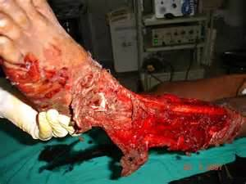
Crush Injuries
An injury caused by pressure from a heavy object
on body part. It can also be caused by the squeezing
of a body part between two objects.
MedicineNet.com, 2012
Citywide ED Orientation - May 2015
Notes:
MedicineNet.com, 2012, Definition of Crush Injury. Retrieved Dec. 2012, from http://www.medterms.com/script/main/art.asp?articlekey=105198

Slide 16
Can occur anywhere
Can vary in depth, width and significance
Can cause (significant) damage to underlying
tissues
Depending on significance, can cause bleeding,
skin breakdown, muscle damage
(rhabdomyolysis), nerve damage, fractures…….
loss of life.
Citywide ED Orientation - May 2015

Slide 17
Always assess: vital signs; neurovascular status:
circulation, mobility, sensation; pain.
When possible, assess for possible damage to underlying tissues (e.g. if patient suffered a
crush injury to flank, check to see if patient
has bloody urine)
Citywide ED Orientation - May 2015

Slide 18
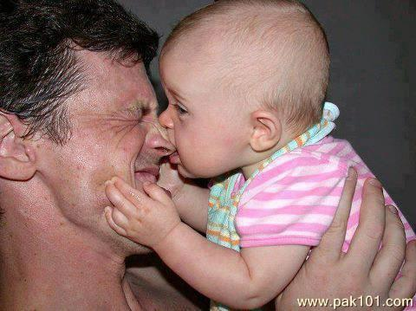
Bites
Most commonly caused by dogs
Can occur anywhere
Varies in damage caused
Human bite – worse than most dog or cat bites
due to bacteria transmitted.
Citywide ED Orientation - May 2015

Slide 19
Always check current protocol for reporting these bites.
Always determine whether animal is up-to-date on rabies shots.
Public Health Department will be notified.
LPD is notified only if patient wishes to press
charges.
Citywide ED Orientation - May 2015

Slide 20
Occasionally, rabies immunization begins in the ED
This includes immunoglobulin as well as vaccination (RIG).
Amount determined by patient weight (20 IU/kg).
Vaccination provided by public health; stored
  in fridge (Given IM on days 0, 3, 7, 14, 28).
Citywide ED Orientation - May 2015

Slide 21
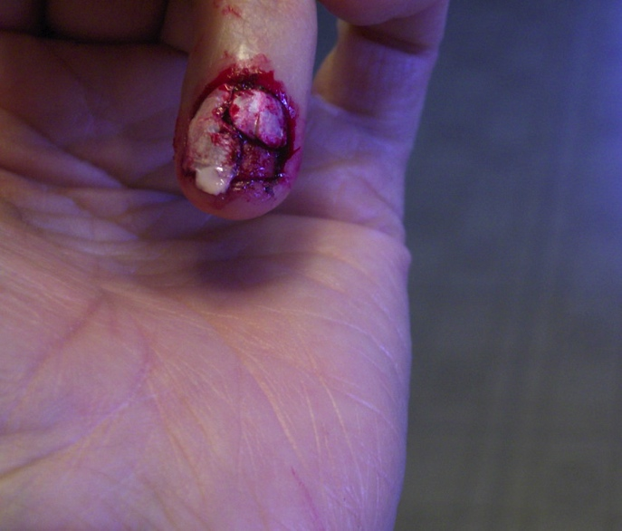
Avulsions
The tearing away of skin
Commonly referred to in an injury in which all layers of skin have been forcibly removed causing underlying exposure.
Medical treatment dependent
on injury sustained.
Citywide ED Orientation - May 2015

Slide 22
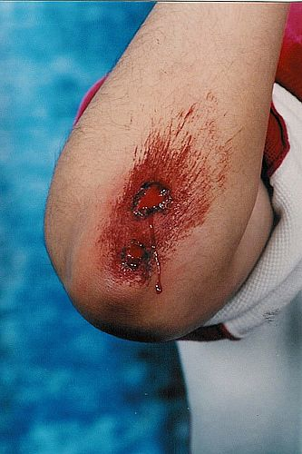
Abrasions
Superficial injury to the skin, causing damage to epidermis only
Often caused by falling on hard surface
Sometimes coined ‘road rash’
Requires thorough cleansing, perhaps scrub
Citywide ED Orientation - May 2015
Notes:
To avoid tattoo

Slide 23
Puncture Wounds
Results from a sharp object penetrating the skin creating a small hole.
Can be deep or superficial.
Bleeding is usually limited.
Ensure no foreign body remains in wound.
Citywide ED Orientation - May 2015
Notes:
Air gun injuries – can be misleading. Small wound but damage to surrounding tissues occurs from the transfer of kinetic energy

Slide 24
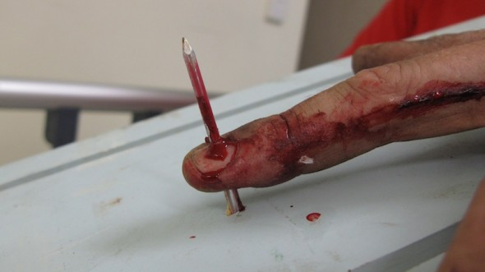
Nail Gun Injuries, 2010
Citywide ED Orientation - May 2015
Notes:
Life in the Fast Lane (2010). Nail Gun Injuries. Retrieved Jan 5, 2013 from http://lifeinthefastlane.com/gmep/

Slide 25
Needle-stick Injuries
Check patient’s tetanus status
Determine source of possible transmission
Anticipate blood work
Citywide ED Orientation - May 2015

Slide 26
Nursing Assessment for
Patients Presenting with Traumatic Skin Disruption
A- B- C (always, always, always!!!)
Vital signs, Neurovascular checks
Check for possible underlying injury
Be aware of any existing co-morbidities that affect healing.
Citywide ED Orientation - May 2015
Notes:
Such as: diabetes, chemo,, steroids

Slide 27
Assessments
Assess pain – location, extent, radiation, quality
Apply pressure to stop bleeding
Cleanse and cover where appropriate
Check tetanus status
Citywide ED Orientation - May 2015
Notes:
Discuss how to determine whether one has had recent tetanus update

Slide 28
Tetanus Immunizations
Tetanus is an infection caused by the bacteria
Clostridium Tetani.
Tetanus is acquired by contact with the bacteria
through open wounds.
Incubation 2 to 14 days.
Usually give: Td 0.5mL IM (usually deltoid)
Citywide ED Orientation - May 2015

Slide 29
Patients who have never been immunized will
require TIG (tetanus immunoglobulin) as well,
followed by several Td boosters the
first year. A booster shot is required every 10 yrs.
thereafter.
Document Lot number when signing of medications
(HUGO)
Citywide ED Orientation - May 2015

Slide 30
Health Teaching
Be sure to provide your discharged patients
with instruction sheet “Wound
Care.”
Prior to discharge, review these written instructions with your patient.
Document that this was completed.
Citywide ED Orientation - May 2015
Notes:
Important for legal purposes

Slide 31
Discharge Instructions
Sign on to FirstNet, click on FRED,
Go to D – discharge
Look for appropriate discharge instruction information sheet
Citywide ED Orientation - May 2015

Slide 32
Skin Infections
Cellulitis
Abscesses
Wound infections
Ulcers
Citywide ED Orientation - May 2015

Slide 33
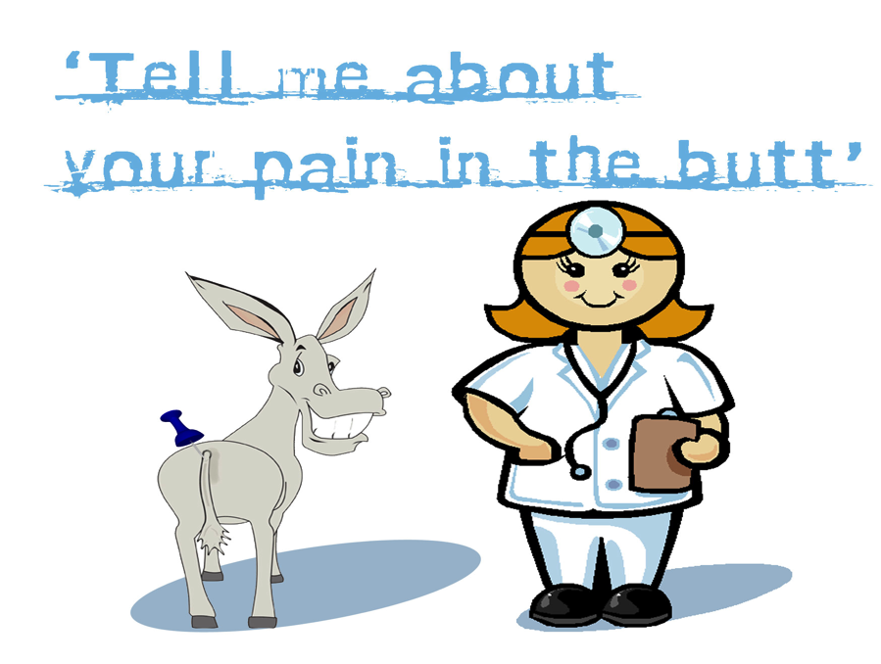
Common ED Presentations - Abscesses
Perianal Abscess
Citywide ED Orientation - May 2015

Slide 34
More common in males
Seen in infants
An infection of the soft tissues surrounding the anal canal
Diarrhea
Can reoccur
Poor hygiene
Citywide ED Orientation - May 2015
Hebra& Geibel, 2012

Slide 35

Pilonidal Cysts
Common in adults aged 15-24; seen more in males, Caucasians
Thought to be penetration
of loose hairs
through the skin
Citywide ED Orientation - May 2015

Slide 36

Occurs right below tailbone near the cleft of the buttocks
I & D if abscessed
Can become an abscess
Citywide ED Orientation - May 2015

Slide 37
Nursing Care for these abscesses
Home care referral
After I&D: wound will likely need packing
Pain control
Health teaching
Antibiotics not standard
Citywide ED Orientation - May 2015

Slide 38
Abscesses from Intravenous Drug Use
Sepsis
endocarditis
Epidural abscesses
Staph infections are most common
cellulitis
Emergency Medicine News, 2010; Treatment4Addiction, 2011
Citywide ED Orientation - May 2015
Notes:
Emergency Medicine News, (2010) ID Rounds, Think Spinal Epidural Abscess in Nontraumatic Back, 32(6) 6, p. 8-9
doi: 10.1097/01.EEM.0000381473.07156.08
Treatment4Addiction, 2011, Intravenous Drug Use Infections, Retrieved Dec. 30, 2012 from: http://www.treatment4addiction.com/addiction/iv-drug-use-infection/

Slide 39
Nursing Care:
Be non-judgmental
Universal Precautions
Likely antibiotics, ?I&D
CCAC
Monitor closely for systemic illness, including sepsis
Supportive Care
Citywide ED Orientation - May 2015

Slide 40
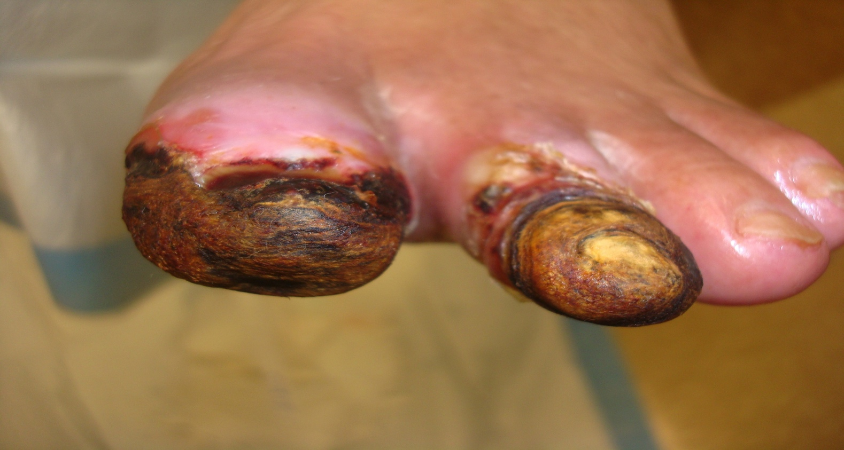
Diabetic Foot Ulcers
Citywide ED Orientation - May 2015

Slide 41
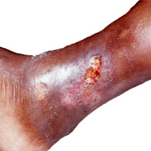
Venous Stasis Ulcers
Citywide ED Orientation - May 2015

Slide 42
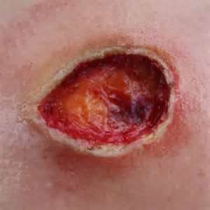
Pressure Ulcers
Citywide ED Orientation - May 2015

Slide 43
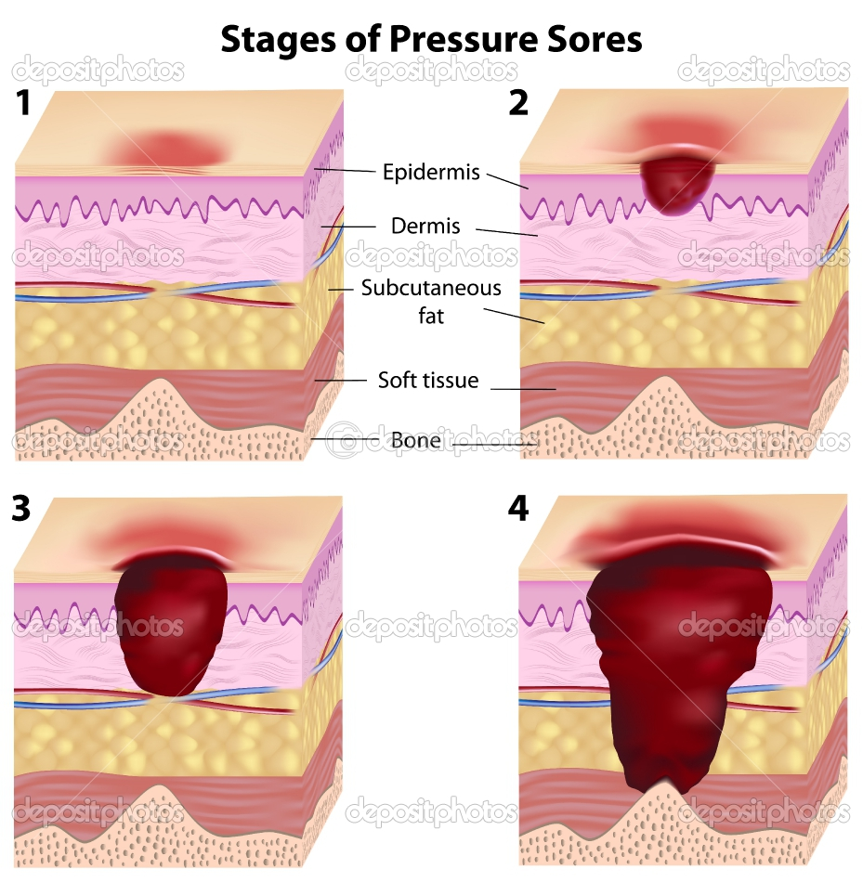
Citywide ED Orientation - May 2015

Slide 44
Nursing Care
Health teaching
Turn your patients at least every two hours
Inspect, Assess & Document
Citywide ED Orientation - May 2015

Slide 45
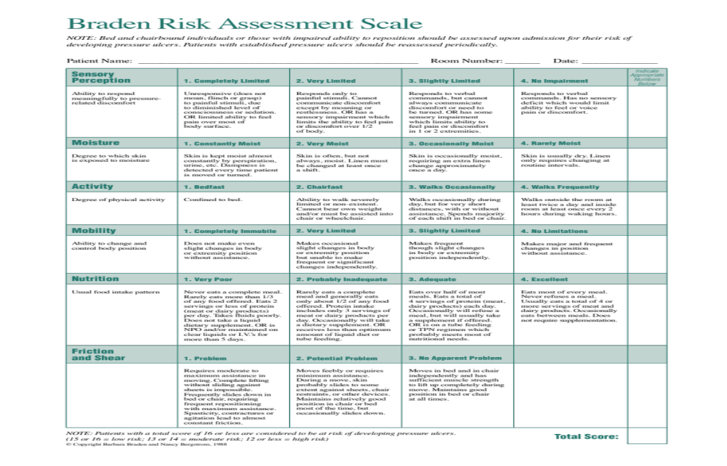
Citywide ED Orientation - May 2015

Slide 46
Post-op Wound Infections
Vital signs
Assess: size, depth, colour, tenderness, edema, pain, odour
Co-morbidities
Systemic symptoms: Malaise, Fever, Nausea, Anorexia,
Dehiscence/ Evisceration
Citywide ED Orientation - May 2015

Slide 47
Rashes
Most causes remain undetermined
Viral, bacterial, fungal
Contact dermatitis
?Contagious
Hives
Does pt. need isolation?
Citywide ED Orientation - May 2015

Slide 48
Assessments
Itchy?
Bugs?
Colour of rash, skin
Pain
Lesions – open, crusted, pustules
Vital signs, including temperature
Look for possible systemic response
Citywide ED Orientation - May 2015

Slide 49
Nursing Documentation
With all skin alterations, accurate documentation is essential. Document where, how, extent of wound, appearance of wound (colour, edema, discharge, radiation), pain, pre-hospital care.
Citywide ED Orientation - May 2015

Slide 50
Document any changes that occur.
Document all care provided & patient’s response
Document vital signs, neurovascular checks,
fluid balance,
Document all discharge info: instructions (what
they were), medications, follow-up.
Citywide ED Orientation - May 2015

Slide 51
References
Burn Injury Recovery Center, (n.d.). About Burn Injuries; Retrieved Dec. 31, 2102 from http://www.burn-recovery.org
Canadian Skin Patient Alliance. (n.d.). Burns, Retrieved Dec. 31, 2012 from
http://www.skinpatientalliance.ca/index.php?option=com_content&view =category&layout=blog&id=13&Itemid=92
Hebra, A., (2012). Perianal Abscess. Medscape Reference: Drugs, Diseases & Procedures. Retrieved Dec. 22, 2012
Emedicinehealth, (2012). Burn Percentage in Adults: Rule of Nines, Retrieved Dec. 31, 2102 from
http://www.emedicinehealth.com/burn_percentage_in_adults_rule_of_nines/article_em.htm
Emergency Medicine News, (2010). ID Rounds, Think Spinal Epidural Abscess in Nontraumatic Back, 32(6) 6, p. 8-9
doi: 10.1097/01.EEM.0000381473.07156.08
Emergency Nurses Association, (2000). Trauma Nursing Core Course, 5th ed. Emergency Nurses Association.
Life in the Fast Lane, (2010). Nail Gun Injuries. Retrieved Jan 5, 2013 from http://lifeinthefastlane.com/gmep/
Medscape, (2012) Burn Resuscitation and Early Management. Retrieved Dec. 31, 2102 from
http://emedicine.medscape.com/article/1277360-overview#aw2aab6b3
Citywide ED Orientation - May 2015

Slide 52
References
MedicineNet.com. (2012). Definition of Crush Injury. Retrieved Dec. 2012, from http://www.medterms.com/script/main/art.asp?
articlekey=105198
MedicineNet.com. (2012) Hematomas. Retrieved Jan 3, 2012 from http://www.medicinenet.com/hematoma/article.html
National Emergency Nurses Association (2011). Professional Practice: Emergency Nursing Core Competencies. Retrieved
January 27, 2014 from: http://nena.ca/public/b/about/archive/2010/01/10/professional-practice-emergency-nursing-core-
competencies.aspx
Treatment4Addiction. (2011). Intravenous Drug Use Infections, Retrieved Dec. 30, 2012 from: http://www.treatment4addiction.com/
addiction/iv-drug-use-infection/
Van Houwelingen, J. & Sullivan, L. (2010). Citywide ED Orientation.
Citywide ED Orientation - May 2015

